Slide 1
ECommerce Product Recommendation System
By-
Aakash Maurya (2029001)
Soumyadip Dhara (2029116)
Abhishek Kumar (2029156)
Abhinav Mishra (2029167)
Alapan Pradhan (2029190)

Slide 2
Cold Start Problem
The cold start problem is a common challenge encountered by recommender systems, which are algorithms designed to provide personalized suggestions to users. This issue arises when the recommender system lacks sufficient data to generate accurate recommendations for either a new user or a recently added item. There are two primary categories of cold start problems
User cold start: This occurs when a new user signs up for a service and the recommender system does not have any information about their past behavior.
Item cold start: This occurs when a new item is added to a service and the recommender system does not have any information about how other users have rated it.

Slide 3
User Cold Start
Definition: This scenario occurs when a new user registers for a service, and the recommender system has no historical data or information about their preferences and behavior.
Challenge: Without past user interactions, it becomes challenging for the recommender system to understand the user's tastes, making it difficult to provide relevant and personalized recommendations.
Solution: Strategies such as rank-based recommendations or collaborative filtering can be employed to suggest popular items or leverage the preferences of similar users.

Slide 4
Item/Product Cold Start
Definition: Item cold start happens when a new item is introduced to the service, and there is no existing data on how other users have rated or interacted with it.
Challenge: Lack of historical data on the new item makes it hard for the recommender system to assess its popularity or relevance to users.
Solution: Content-based filtering methods, which rely on the attributes or metadata of items, can be utilized to make recommendations based on the inherent characteristics of the new item.

Slide 5
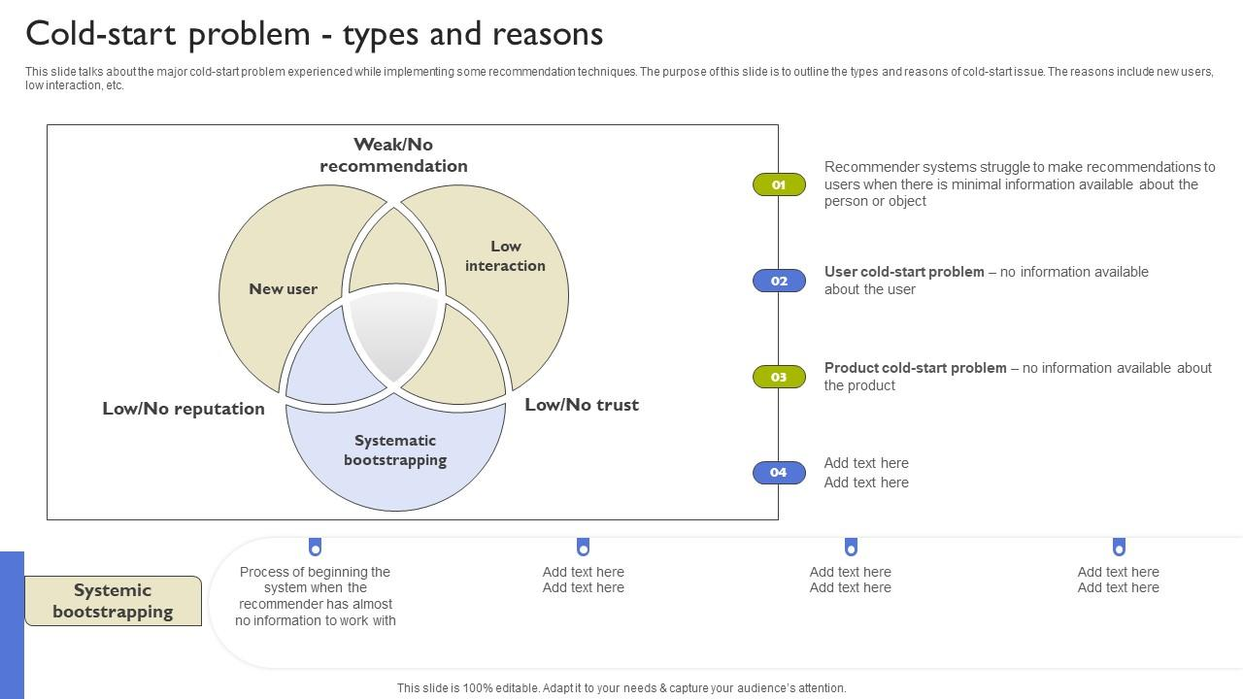

Slide 6
Cold-Start-Problem Reasons
Systematic Bootstrapping : Systemic bootstrapping refers to the starting of the system when there is almost no information on which the recommender may rely. As all assets and users are new, this example demonstrates the drawbacks of both the minimal interaction and the New user cases. As a result, several of the approaches established to cope with those two scenarios are unsuitable for system bootstrapping.
Low Interaction : When things are added to the catalogue, the item cold-start problem occurs when they have no or very few interactions. This is particularly problematic for collaborative filtering algorithms, which generate recommendations based on the item’s interactions. A pure collaborative algorithm cannot recommend an item if there are no interactions available.

Slide 7
Cold-Start-Problem Reasons
New User : The new user case occurs when a new user enrols in the system and the recommender is required to offer recommendations for a set length of time without depending on the user’s previous interactions, as none have been recorded yet.
This issue is especially important when the recommender is part of the service provided to users, because a user who receives poor-quality recommendations may opt to left the system before giving enough interaction to allow the recommender to understand his or her interests.
When dealing with new users, the primary technique is to ask them to offer certain preferences in order to create an initial user profile. You may have seen such interaction on Netflix.

Slide 8
Approaches
The cold start problem, in the context of recommender systems, presents a significant challenge when making recommendations for new users or items that lack substantial interaction data. To tackle this issue, several approaches can be employed:
Rank-Based Recommendations:
Description: This approach involves recommending popular items based on their overall popularity or average rating. It doesn't rely on specific user preferences, making it suitable for new users.
Benefits: Introduces users to items that have demonstrated broad popularity on the platform.

Slide 9
Content-Based Filtering:
Description: Content-based filtering recommends items based on their attributes or metadata. For new items, this method leverages the inherent characteristics of the item itself, requiring no interaction data.
Benefits: Introduces new items to users with similar preferences, focusing on the content and features of the items.
Hybrid Approaches:
Description: Hybrid approaches combine multiple recommendation strategies to address the cold start problem comprehensively. For instance, using rank-based recommendations for new users and content-based filtering for new items.
Benefits: By blending different approaches, hybrid methods aim to provide more accurate and diverse recommendations, mitigating the limitations of individual strategies.

Slide 10
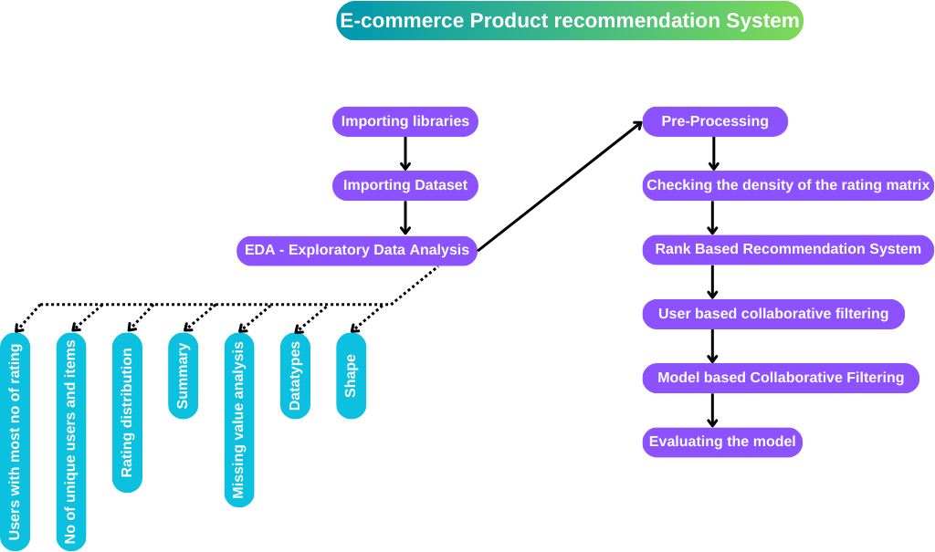

Slide 11
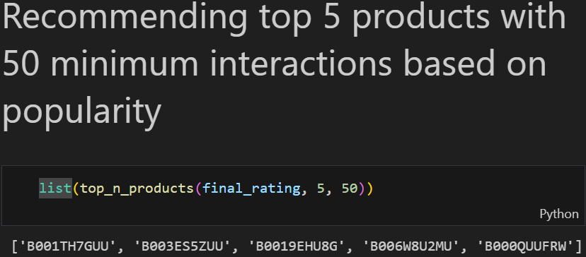
1) Rank Based Product Recommendation
Objective -
Recommend products with highest number of ratings.
Target new customers with most popular products.
Outputs -
Recommend top 5 products with 50/100
minimum ratings/interactions.
Approach -
Calculate average rating for each product.
Calculate total number of ratings for each product.
Create a DataFrame using these values and sort it by average.
Write a function to get 'n' top products with specified minimum number of interactions.

Slide 12
2) User based Collaborative filtering
Objective -
Provide personalized and relevant recommendations to users.
Outputs -
Recommend top 5 products based on interactions of similar users.
Approach -
Here, user_id is of object, for our convenience we convert it to value of 0 to 1539(integer type).
We write a function to find similar users -
Find the similarity score of the desired user with each user in the interaction matrix using cosine_similarity and append to an empty list and sort it.
extract the similar user and similarity scores from the sorted list

Slide 13
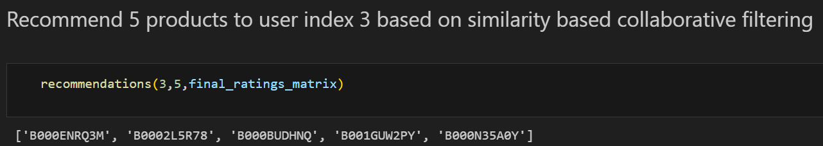
3. remove original user and its similarity score and return the rest.
We write a function to recommend users -
Call the previous similar users function to get the similar users for the desired user_id.
Find prod_ids with which the original user has interacted -> observed_interactions
For each similar user Find 'n' products with which the similar user has interacted with but not the actual user.
return the specified number of products.
Ex-

Slide 14
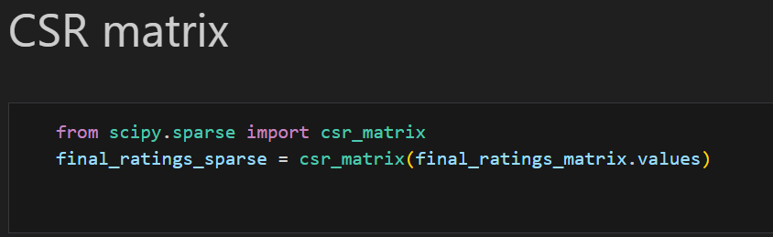
3) Model based Collaborative filtering
Objective -
Provide personalized recommendations to users based on their past behavior and preferences, while also addressing the challenges of sparsity and scalability that can arise in other collaborative filtering techniques.
Outputs -
Recommend top 5 products for a particular user.
Approach -
It is taking the matrix of product ratings and converting it to a CSR(compressed sparse row) matrix. This is done to save memory and computational time, since only the non-zero values need to be stored.

Slide 15
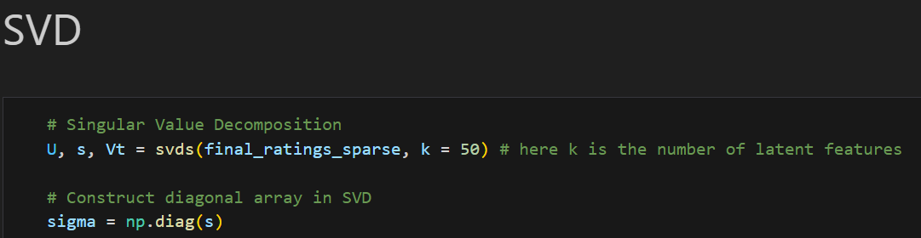
It is performing singular value decomposition (SVD) on the sparse or csr matrix. SVD is a matrix decomposition technique that can be used to reduce the dimensionality of a matrix. In this case, the SVD is used to reduce the dimensionality of the matrix of product ratings to 50 latent features.
It is calculating the predicted ratings for all users using SVD. The predicted ratings are calculated by multiplying the U matrix, the sigma matrix, and the Vt matrix.
It is storing the predicted ratings in a DataFrame. The Data Frame has the same columns as the original matrix of product ratings. The rows of the DataFrame correspond to the users. The values in the DataFrame are the predicted ratings for each user.

Slide 16
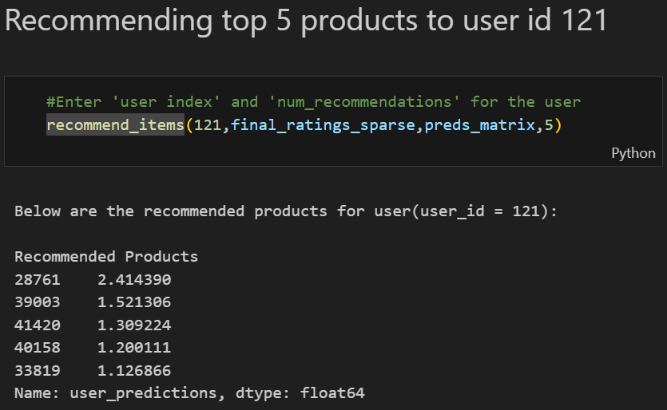
A function is written to recommend products based on the rating predictions made
It gets the user's ratings from the interactions_matrix.
It gets the user's predicted ratings from the preds_matrix.
It creates a DataFrame with the user's actual and predicted ratings.
It adds a column to the DataFrame with the product names.
It filters the DataFrame to only include products that the user has not rated.
It sorts the Data Frame by the predicted ratings in descending order.
It prints the top num_recommendations products.

Slide 17
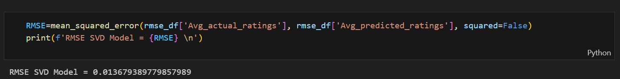
Evaluating the model :
Calculate the average rating for all the movies by dividing the sum of all the ratings by the number of ratings. 2, Calculate the average rating for all the predicted ratings by dividing the sum of all the predicted ratings by the number of ratings.
Create a DataFrame called rmse_df that contains the average actual ratings and the average predicted ratings.
Calculate the RMSE of the SVD model by taking the square root of the mean of the squared errors between the average actual ratings and the average predicted ratings.
The squared parameter in the mean_squared_error function determines whether to return the mean squared error (MSE) or the root mean squared error (RMSE). When squared is set to False, the function returns the RMSE, which is the square root of the MSE. In this case, you are calculating the RMSE, so you have set squared to False. This means that the errors are first squared, then averaged, and finally square-rooted to obtain the RMSE.

Slide 18
Conclusion
In conclusion, the Ecommerce Product Recommendation System effectively addresses the Cold Start Problem in recommender systems, employing rank-based and collaborative filtering approaches. Utilizing an unbiased Amazon dataset, the project ensures personalized and popular product recommendations, enhancing the shopping experience. With robust evaluation metrics like RMSE, the system proves scalable and reliable, aligning with the dynamic needs of e-commerce for increased user engagement and sales.

